Slide 1

Group: Dive In Data
Aswini Pusuluri - 015310269
Heer Parekh - 015270320
Sowmya Ravichandran - 015337400
Vamshi Krushna Lakavath - 015351310
US Housing Market Trends

Slide 2
Project Background
The United States Housing Market is one of the fastest-growing sectors and safest places to invest.
Nowadays, we can see a lot of volatility in the housing market.
Housing prices have touched an all-time high in most US cities
The sudden growth of house prices looks like a bubble because in the past we have seen some housing market crashes like in the 1980s and 2008.
So we want to analyze the housing market data
For that, We have used latest US housing market data from 2016 to 2021
For analysing the prices with demand we have collected US cities’ population from 2016 to 2021

Slide 3

OBJECTIVES
Price Fluctuation From 2016 To 2021.
Best Months To Buy The House.
Percentage Change In The Market Trend In The Past Five Years.
The Cheapest And Costliest Cities To Buy A House In The Us According To Price And Area.
Analyzing The Housing Market Trend During The Covid-19 Pandemic.
Relationship Between Population And Price Per Square Feet
Number Of Active Listed Houses In States Monthly

Slide 4



Project Requirements
Data Requirements
Collecting data from different sources
US Real Estate Market Data
US Population Data
Preprocessing and Merging data using Tableau Prep Builder.

Slide 5

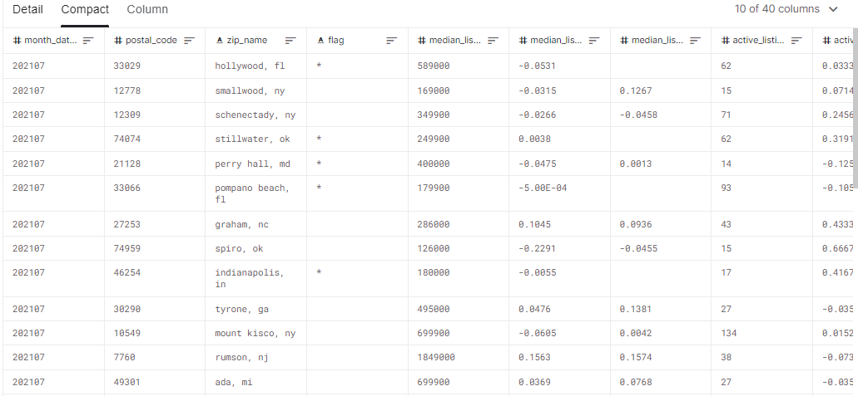
Housing Market Dataset
900K Records

Slide 6

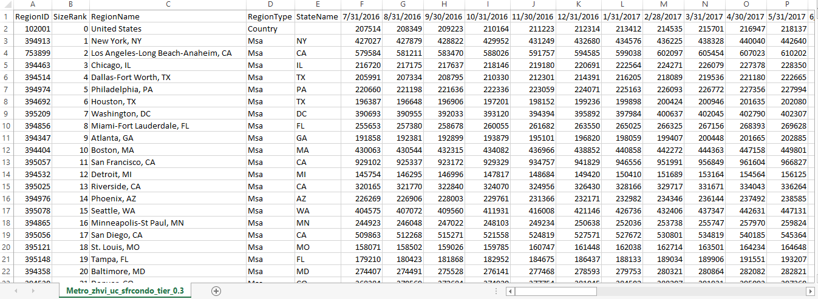
Population Dataset
900+ cities

Slide 7
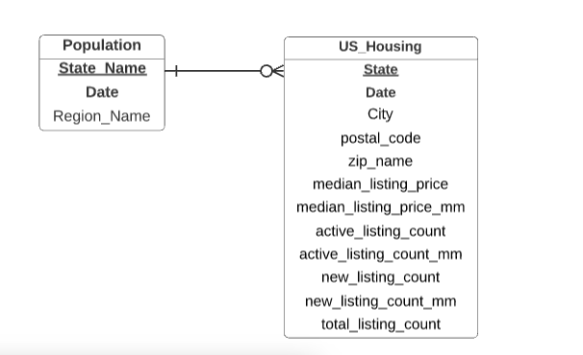
Data Model
This is the overall view of the entire data.
It consists of the entities and their relationships as shown
It gives a One to Many relationship.

Slide 8
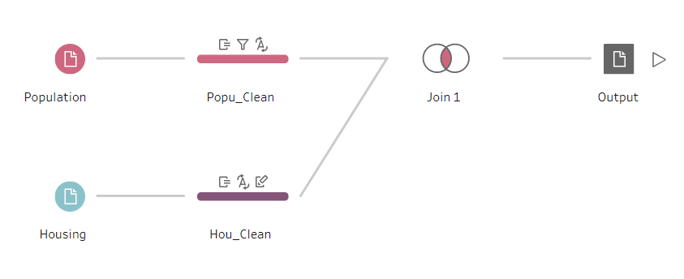
Data Cleaning and Merging pipeline
Tableau Prep Builder.
split the region field as city name and state_id
geographical roles to the city and state fields.
Pivoted the Population dataset using the column to row transformation.
Merged both files on common fields city, date, and state.

Slide 9





Service Requirements
Cloud Services
UI Tools
-To examine and organize data, identifying patterns and sharing insights.
- S3 for loading the merged dataset
- Glue to perform ETL
- Loading data in Redshift
- SageMaker for Data Mining

Slide 10




Security Management
AWS offers services to help safeguard data, accounts, and workloads from illegal access.
IAM - Enables to Securely control access to AWS services.
VPC - Logical container that separates resources that we create from other Amazon cloud customers
Endpoint - endpoint is a virtual device which is horizontally scaled, redundant and highly available, that provides communication between EC2 instances within the Virtual Private Cloud (VPC) and other supported AWS services
AWS Secret manager - The database credentials are kept secret, it is retrieved with a call to Secrets Manager APIs, eliminating the need to hardcode sensitive information in plain text.

Slide 11
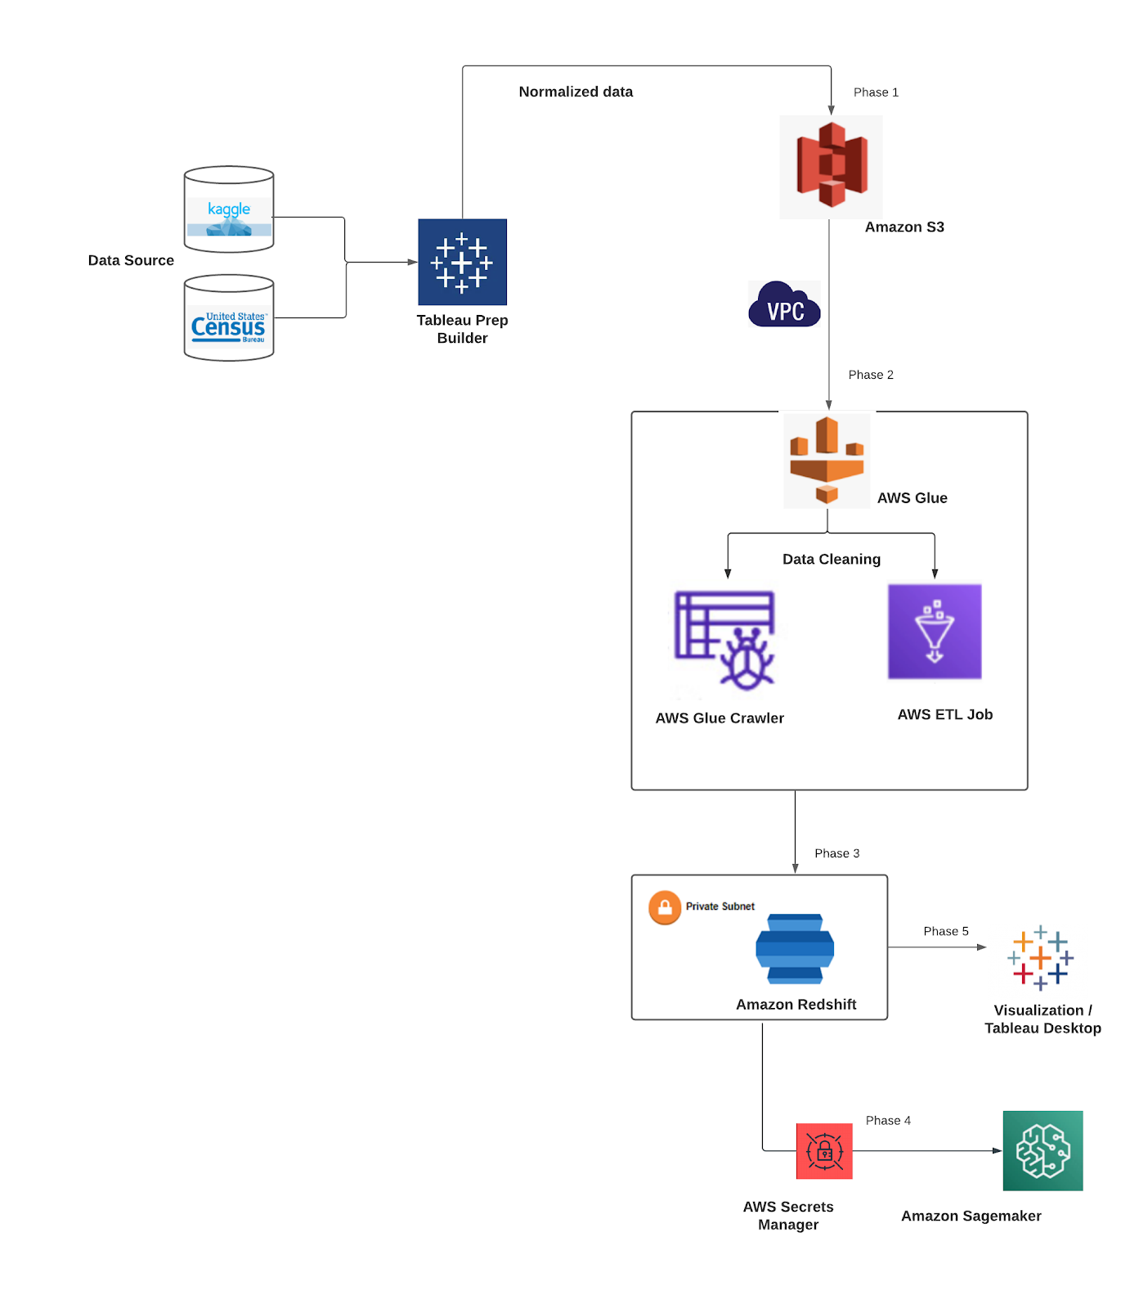
Architecture

Slide 12
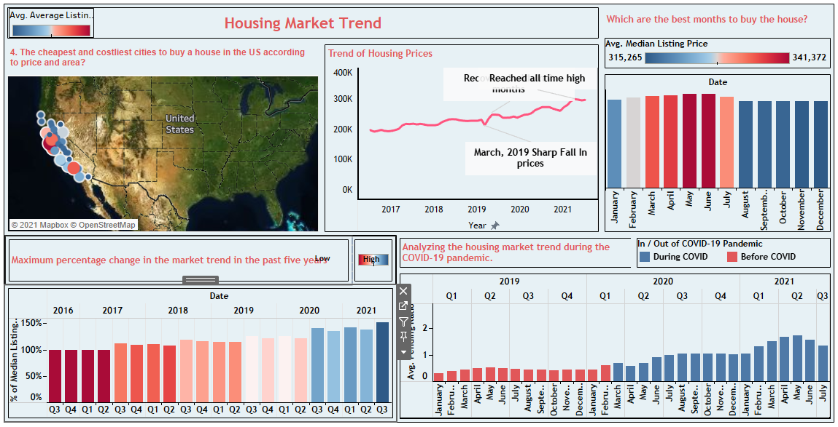
Visualizations-Dashboard 1

Slide 13
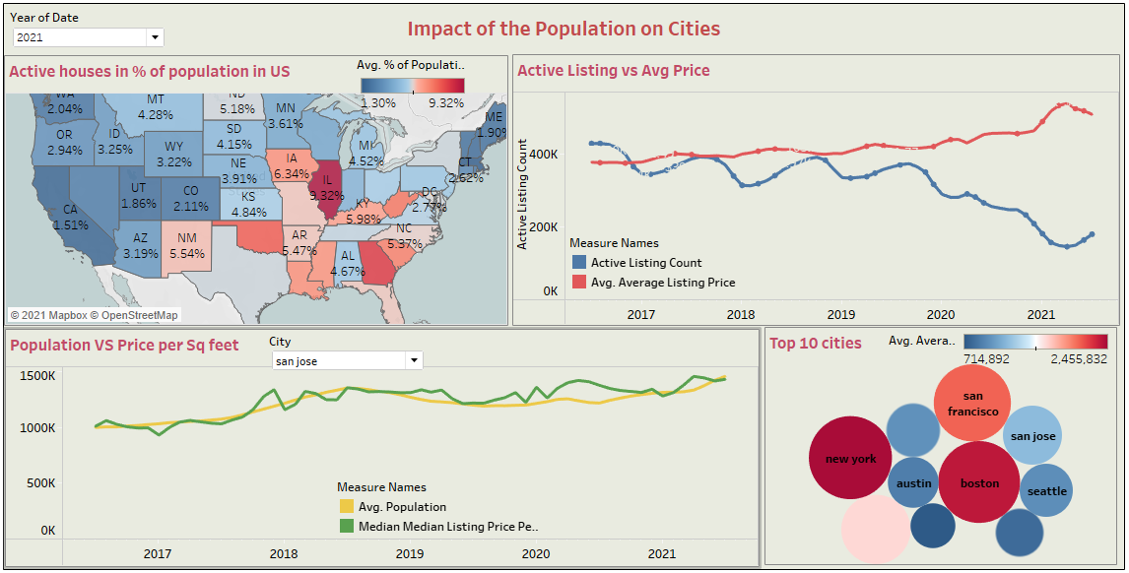
Visualizations-Dashboard 2

Slide 14
Conclusion
We have tried to analyze the US market data to check and see the fluctuations in the price of the houses in the last five years by building a data analytics pipeline.
Different AWS services were used for ingestion,preparation,storage and visualizations.
Efforts were made to understand the batch data, in order create the different trends that could be followed by investors before buying or selling the houses.
Our analysis and visualizations can be used by new and old investors and also any investor or trader who is looking to invest in different cities of US.

Slide 15
Future Work
Check the factors affecting the price of the houses like employment,and salary growth.
The project will be extended by implementing Machine learning algorithms to forecast future prices in various regions across the United States in order to aid smarter investment decisions.
The architecture will be enhanced to make it easier to handle streaming data and provide faster insight into real-time data.

Slide 16
Thank You

